Slide 1
15-780 – Graduate Artificial Intelligence:
Markov Decision Processes
Aditi Raghunathan
Carnegie Mellon University
Spring 2023

Slide 2
Decision making under uncertainty
Building upon our recent discussions about probabilistic modeling, we want to consider a framework for decision making under uncertainty
Markov Decision Processes (MDPs) and their extensions provide a general way to think about how we can act optimally under uncertainty
MDPs introduced in 1950s – 60s
Applications: Robotics, self-driving cars, video games, robot soccer, scheduling and many more..

Slide 3
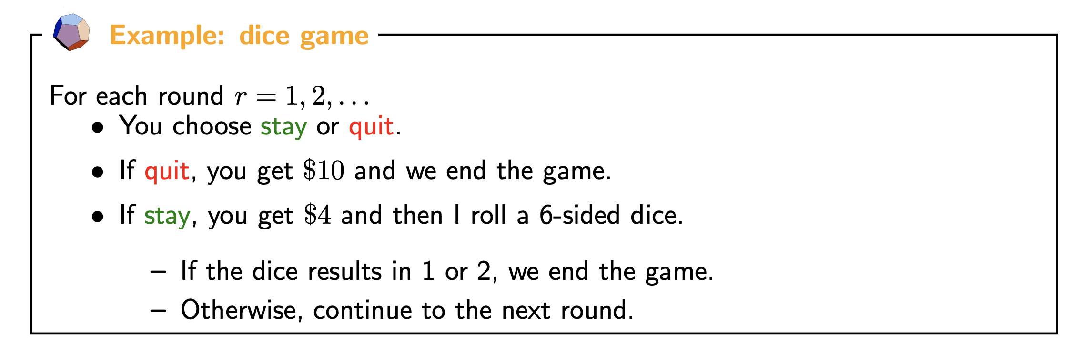
Example MDP
What policy should you follow?

Slide 4
MDP intuition
States encode all the information of a system needed to determine how it will evolve when taking actions
The system is governed via transition probabilities: they only depend on the current state and action; not on the history
Agent starts at a start state, and the goal is to take actions that maximize expected reward

Slide 5
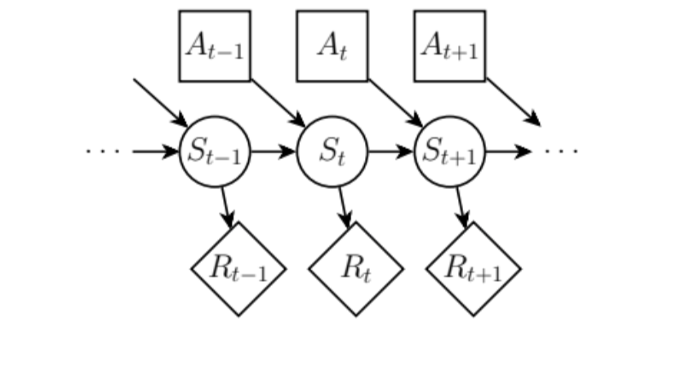
Graphical model representation

Slide 6
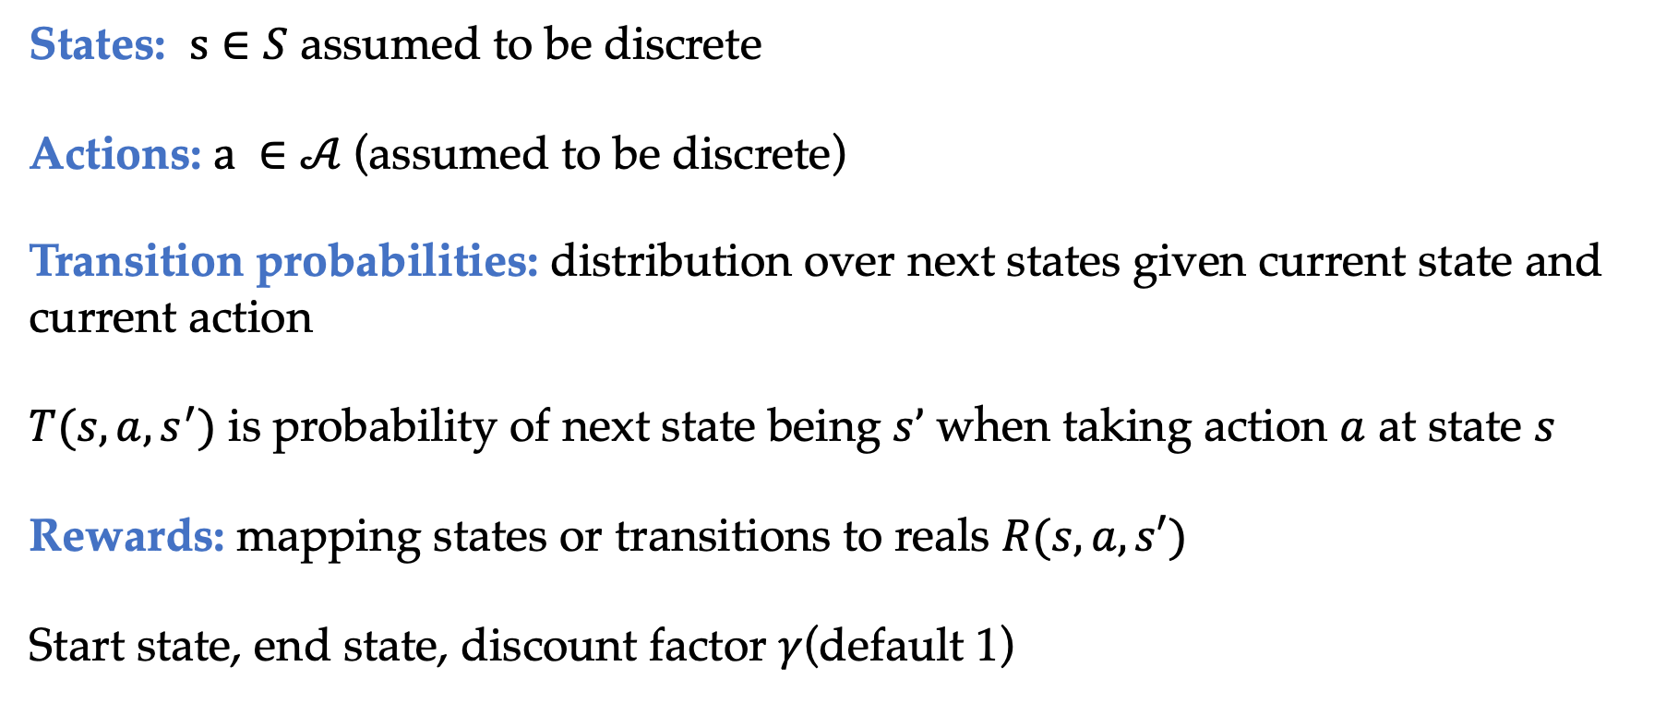
MDPs formal definition
States: $s∈S$ assumed to be discrete
Actions: $a ∈𝒜$(assumed to be discrete)
Transition probabilities: distribution over next states given current state and current action
$T(s, a, s^{′})$ is probability of next state being $s’$ when taking action $a$ at state $s$
Rewards: mapping states or transitions to reals $R(s, a, s′)$
Start state, end state, discount factor $γ$(default 1)

Slide 7
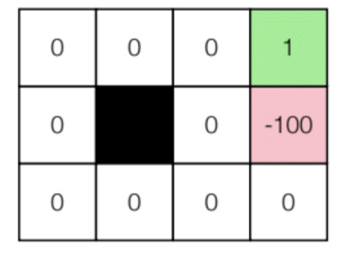
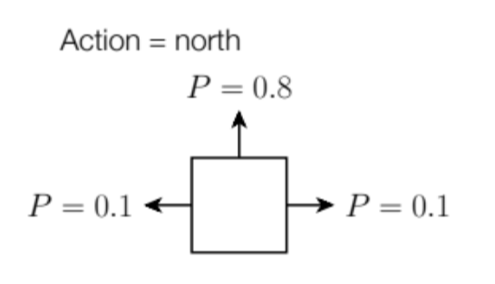
Gridworld domain
Simple grid world with a goal state with reward and a “bad state”with reward -100
Actions move in desired direction with probability 0.8 and one of two perpendicular directions with probability 0.1 each
Taking an action that bumps into a wall leaves agent where it is

Slide 8
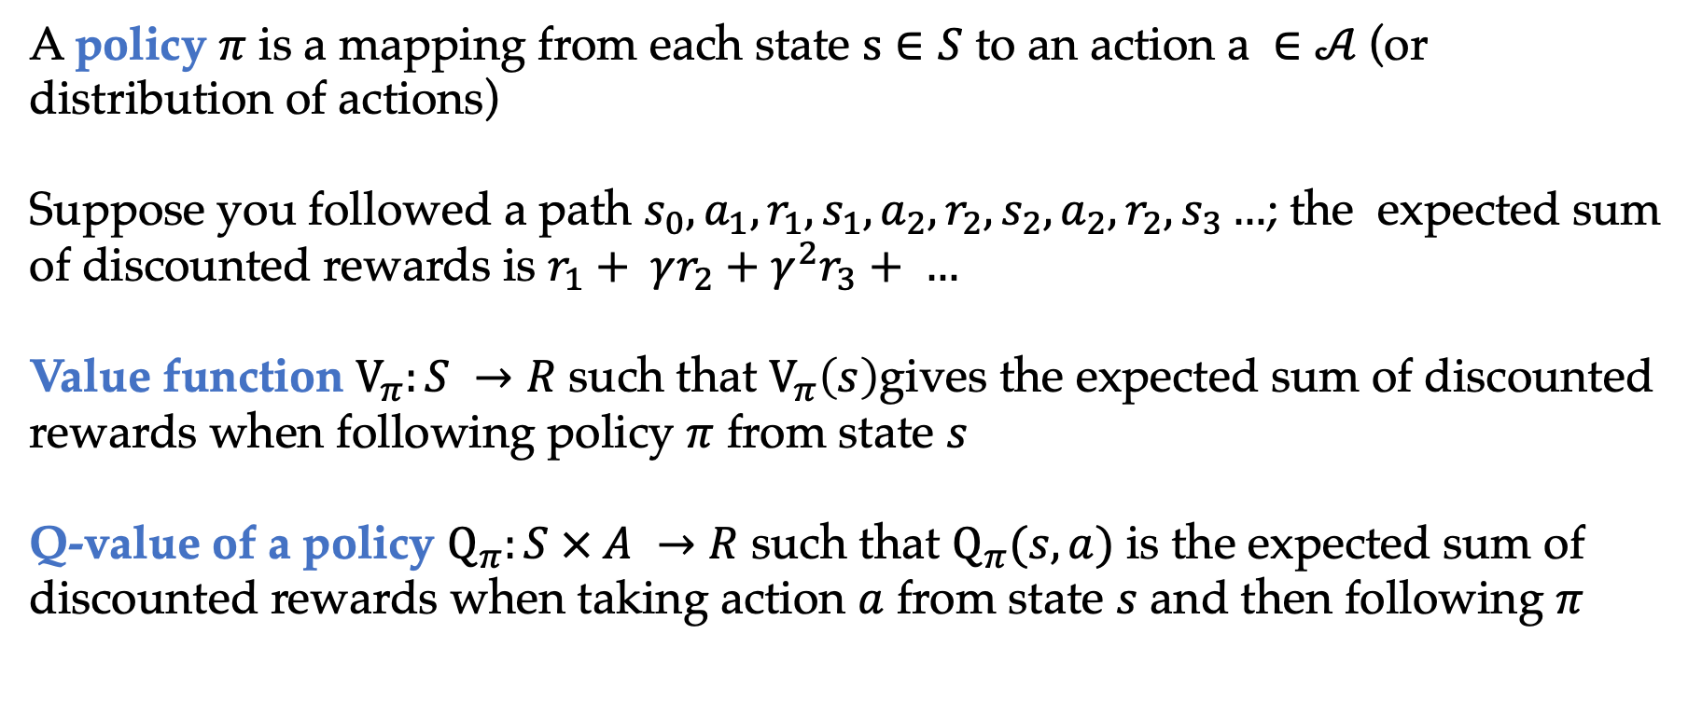
Policy and policy evaluation
A policy $π$ is a mapping from each state $s∈S$ to an action $a ∈𝒜$(or distribution of actions)
Suppose you followed a path $s_{0},a_{1},r_{1},s_{1},a_{2},r_{2}, s_{2},a_{2},r_{2}, s_{3}…$; the expected sum of discounted rewards is $r_{1}+ γr_{2}+γ^{2}r_{3}+ …$
Value function $V_{π}:S →R$ such that $V_{π}\left(s\right)$gives the expected sum of discounted rewards when following policy $π$ from state $s$
Q-value of a policy $Q_{π}:S × A →R$ such that $Q_{π}(s, a)$ is the expected sum of discounted rewards when taking action $a$ from state $s$ and then following $π$

Slide 9
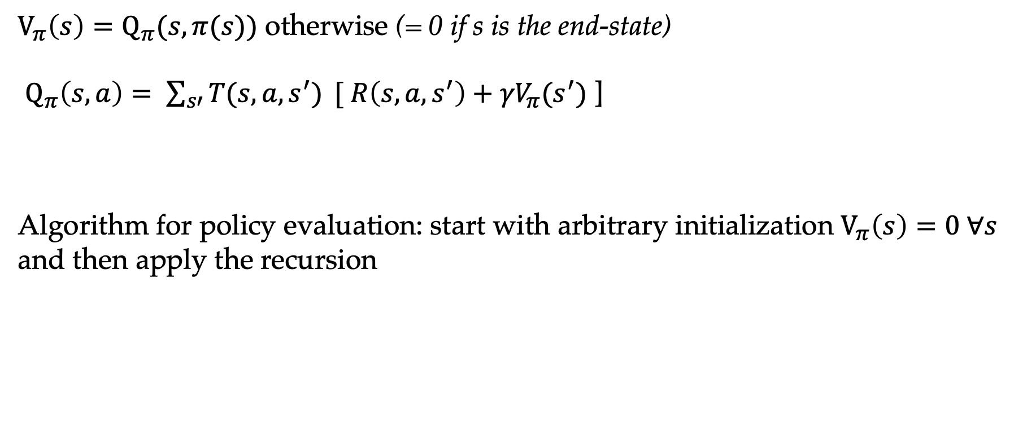
Recursive definitions
$V_{π}\left(s\right)=Q_{π}(s,π(s))$ otherwise (= 0 if s is the end-state)
$Q_{π}\left(s,a\right)= \sum_{s′}{T(s, a, s^{′})} {[ R\left(s, a, s^{′}\right)+γV}_{π}(s^{′})$ ]
Algorithm for policy evaluation: start with arbitrary initialization $V_{π}\left(s\right)=0 ∀s$ and then apply the recursion

